Slide 1
Neural Network & Poker
Kerlin Michel

Slide 2
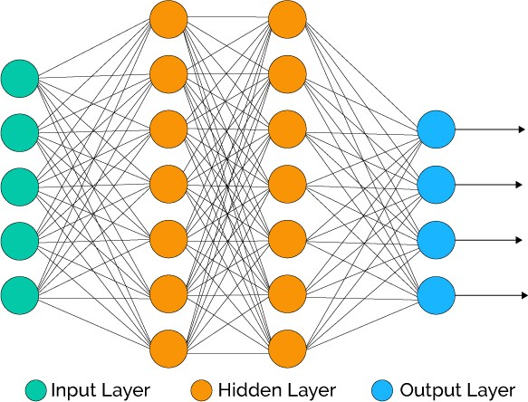

Slide 3
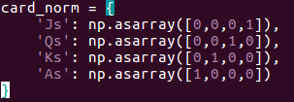

Slide 4
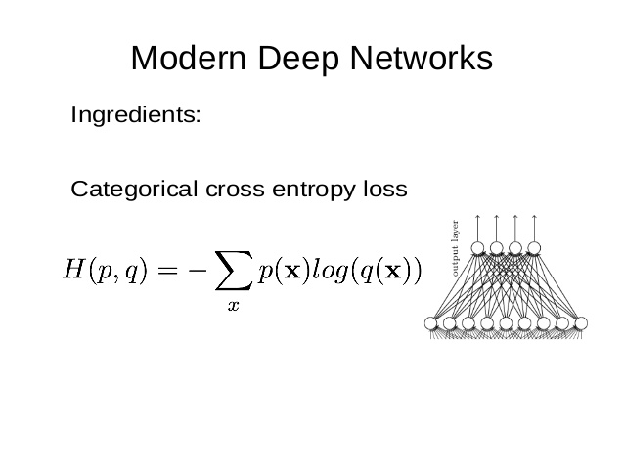
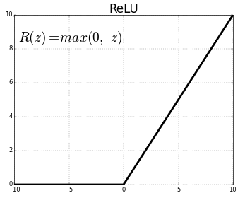

Slide 5
A few layers with 1024 nodes
Softmax to generate probability vector

Slide 6
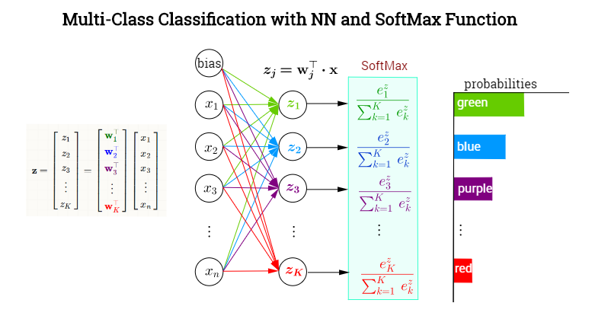

Slide 7
What data is it training on?
2015 ACPC Game logs
A risk or “bluff” score is generated from the showdown in the logs
The input of the network is:
Your Card | P1 Total Average “Bluff” Score | P1 Recent Average “Bluff” Score | P2 Total Average “Bluff” Score | P2 Recent Average “Bluff” Score

Slide 8
What does it do?
Attempts to predict the card the cards of the other players depending on their behaviour

Slide 9
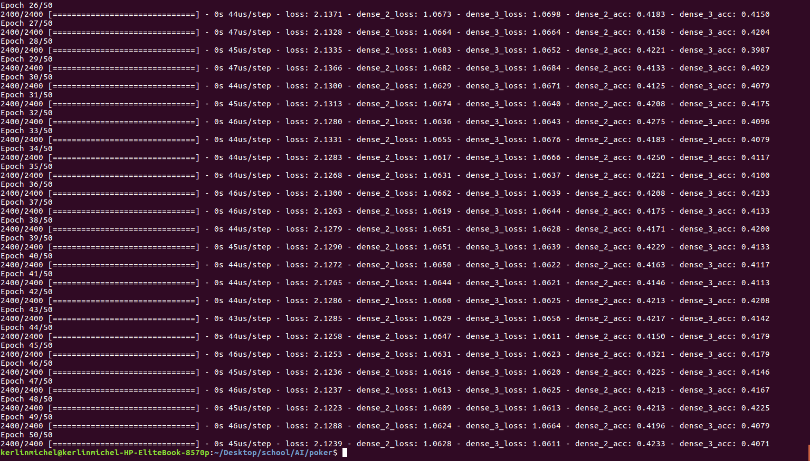
Results

Slide 10
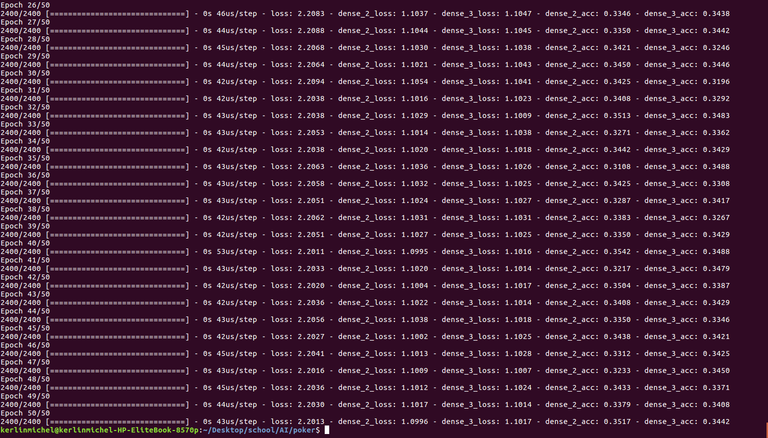
Results without using bluff score

